Slide 1


Distribution and Development of Livestock in New Zealand
Insights from the 2017 Agricultural Census
Presenter: Emma Wang

Slide 2

Outline
Introduction
Results
Conclusion
Appendix

Slide 3
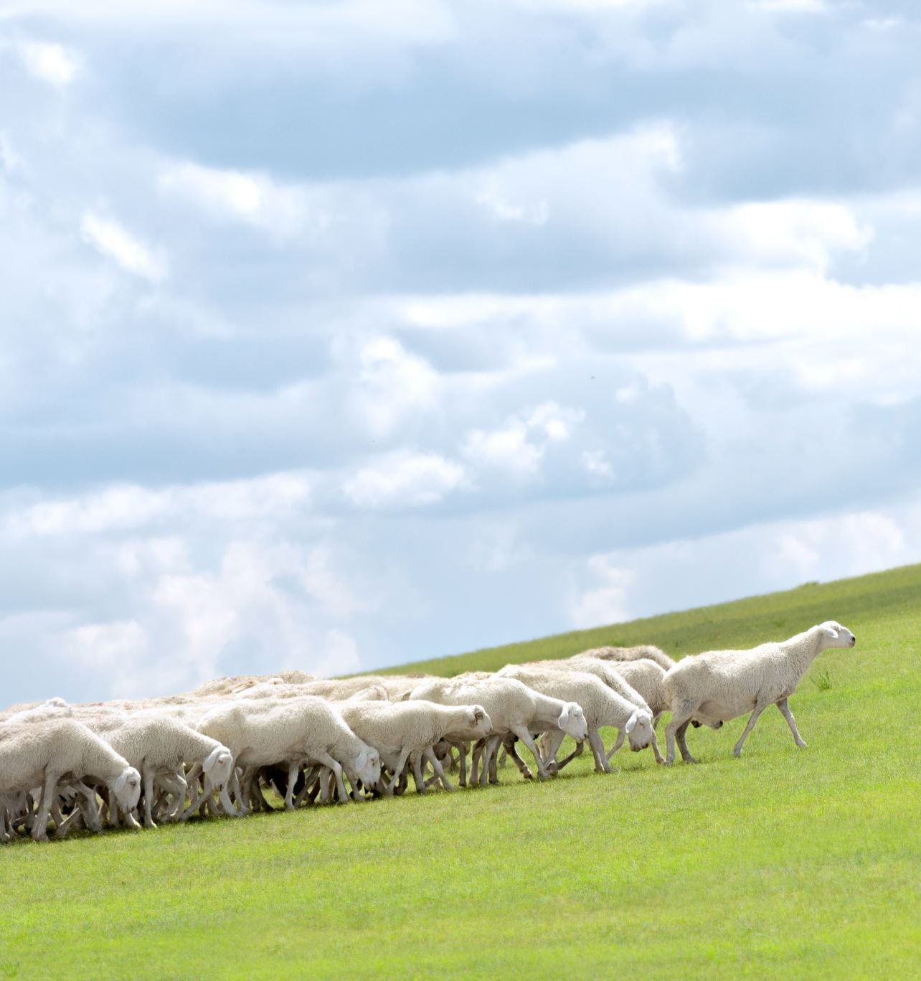
Introduction
Data: Agricultural Census in July 2017
Live stocks
Sheep
Beef Cattle
Dairy Cattle
Regions: See the next page

Slide 4
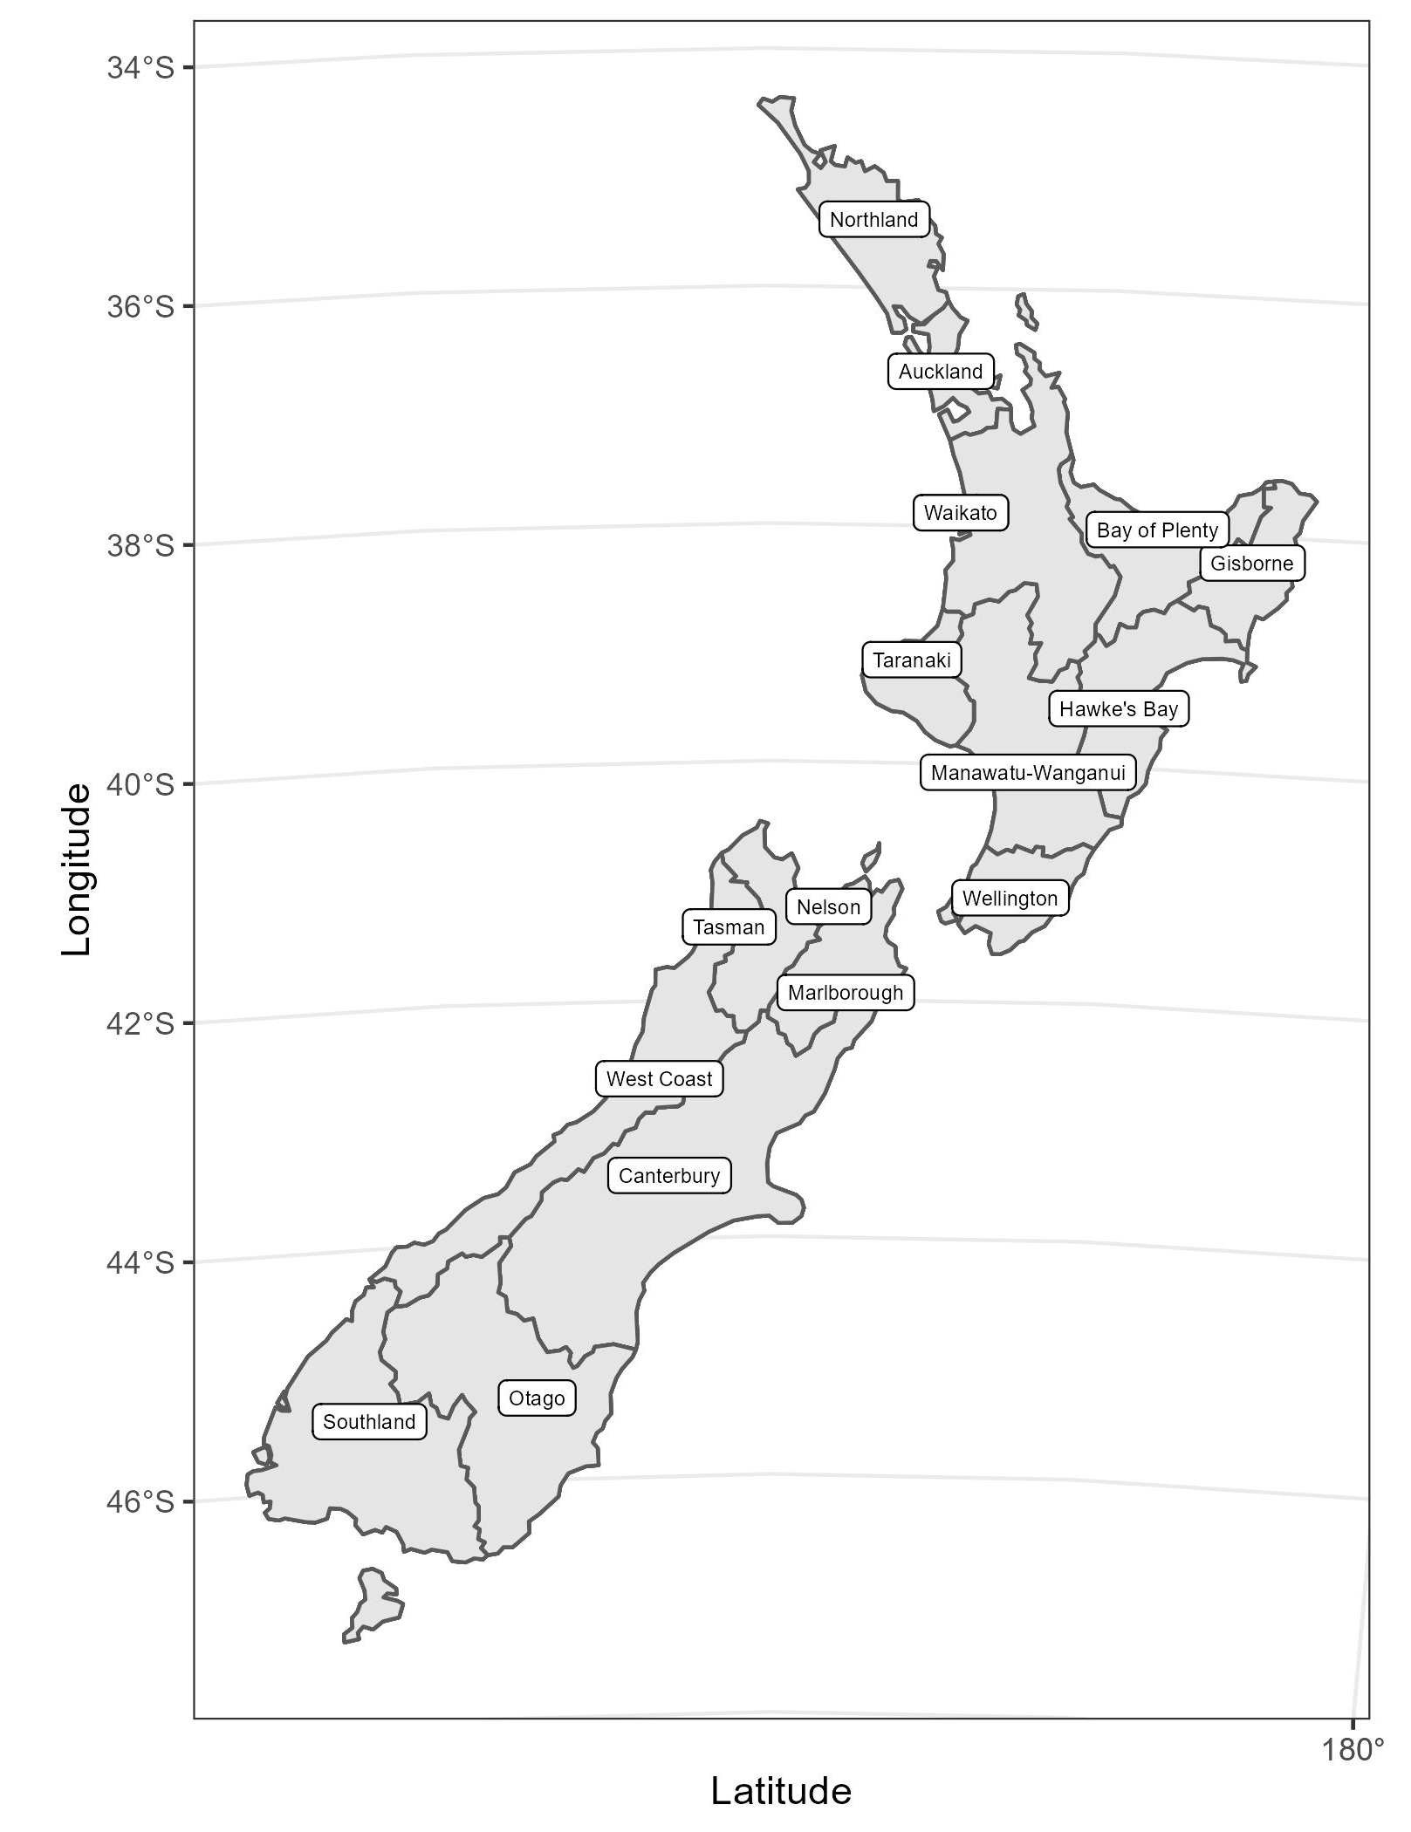
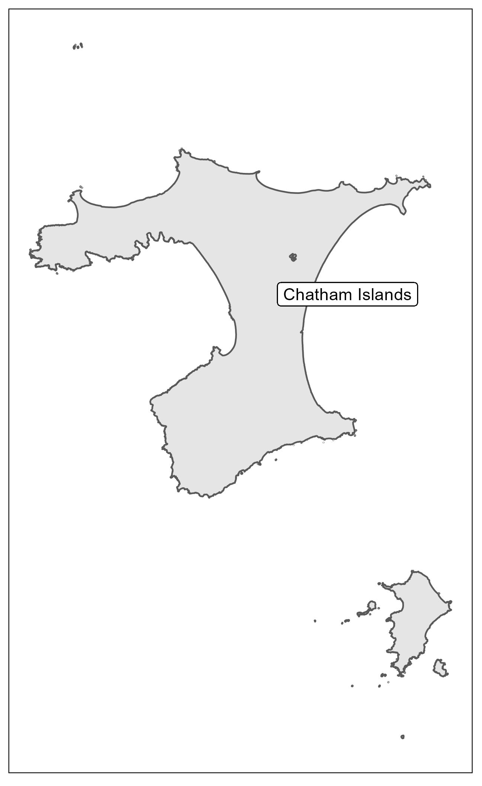
Regions
17 regions included:
9 from the North Island
7 from the South Island
the Chatham Islands
Chatham Islands

Slide 5
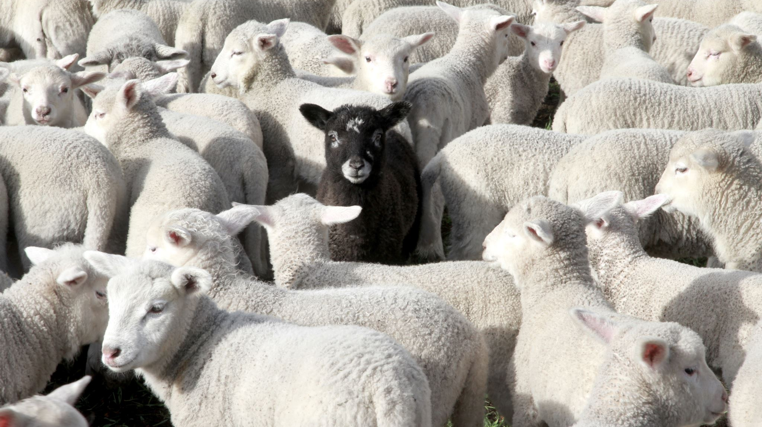
Sheep

Slide 6
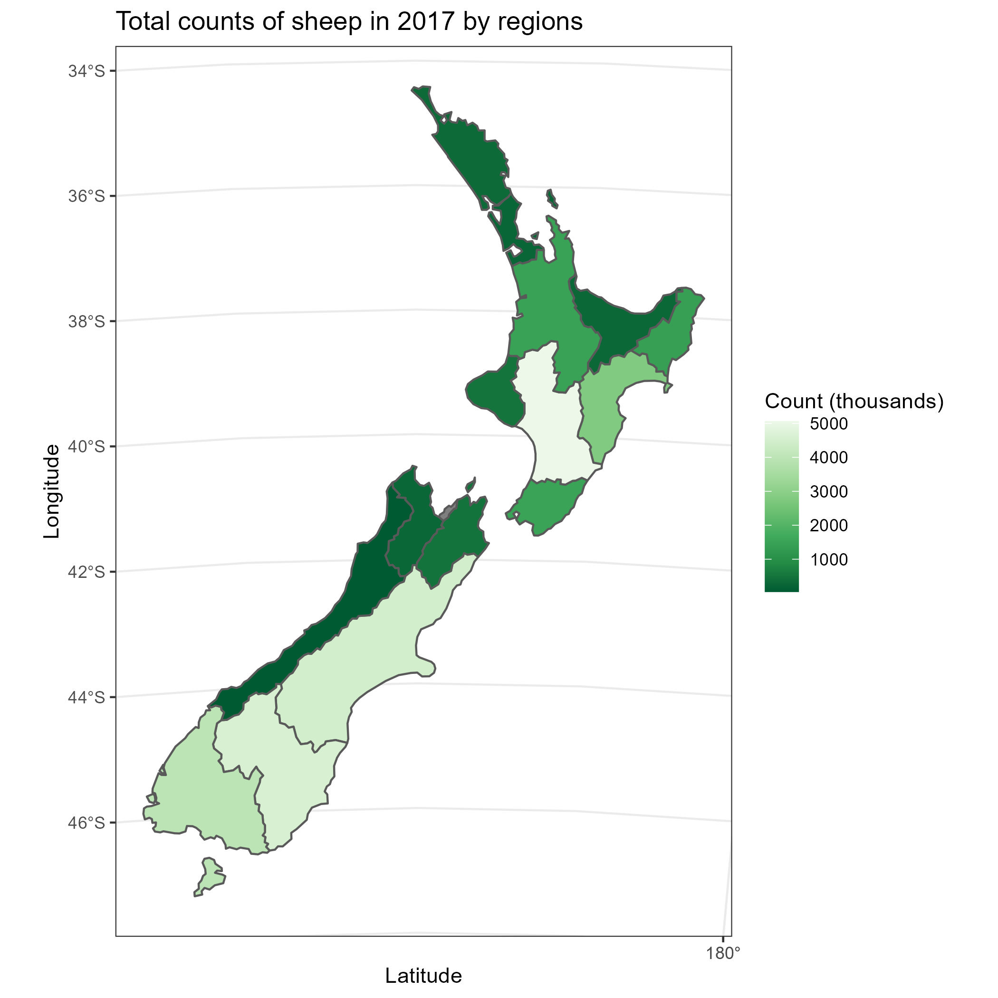
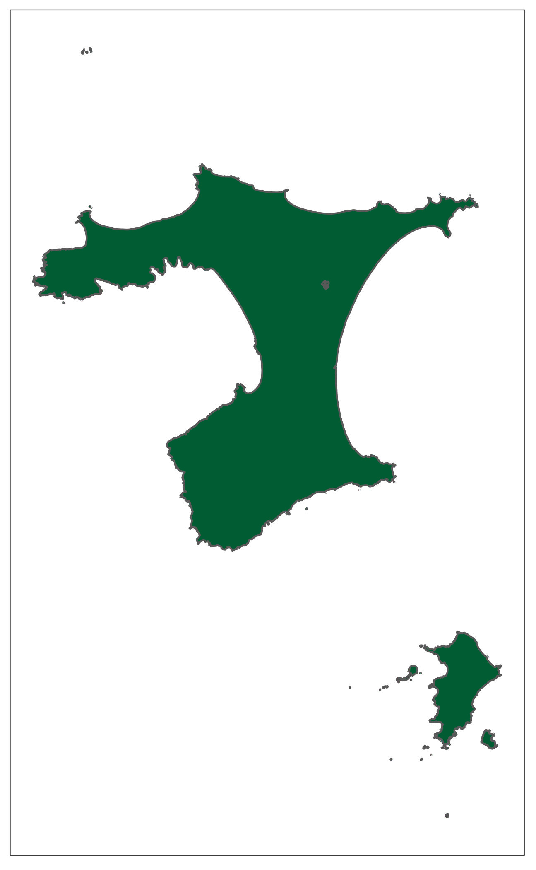
Sheep in 2017
Manawatu-Wanganui
Reading the map:
The lighter the colours, the more live stocks there were
Labelled regions: Regions with the 4000 thousand sheep counts
Southern part of the South Island
Manawatu-Wanganui
Canterbury
Chatham Islands
Otago
Southland

Slide 7
North Island Sheep Counts
Key Findings:
The sheep count in Auckland and Taranaki increased from 2012 to 2017
For the other regions, the trend was negative

Slide 8
South Island Sheep Counts
Key Findings:
Significant reductions (around 15%) in the major sheep farms across Canterbury, Otago and Southland
Increase was only seen in Chatham Islands
Data suppressed: Nelson

Slide 9
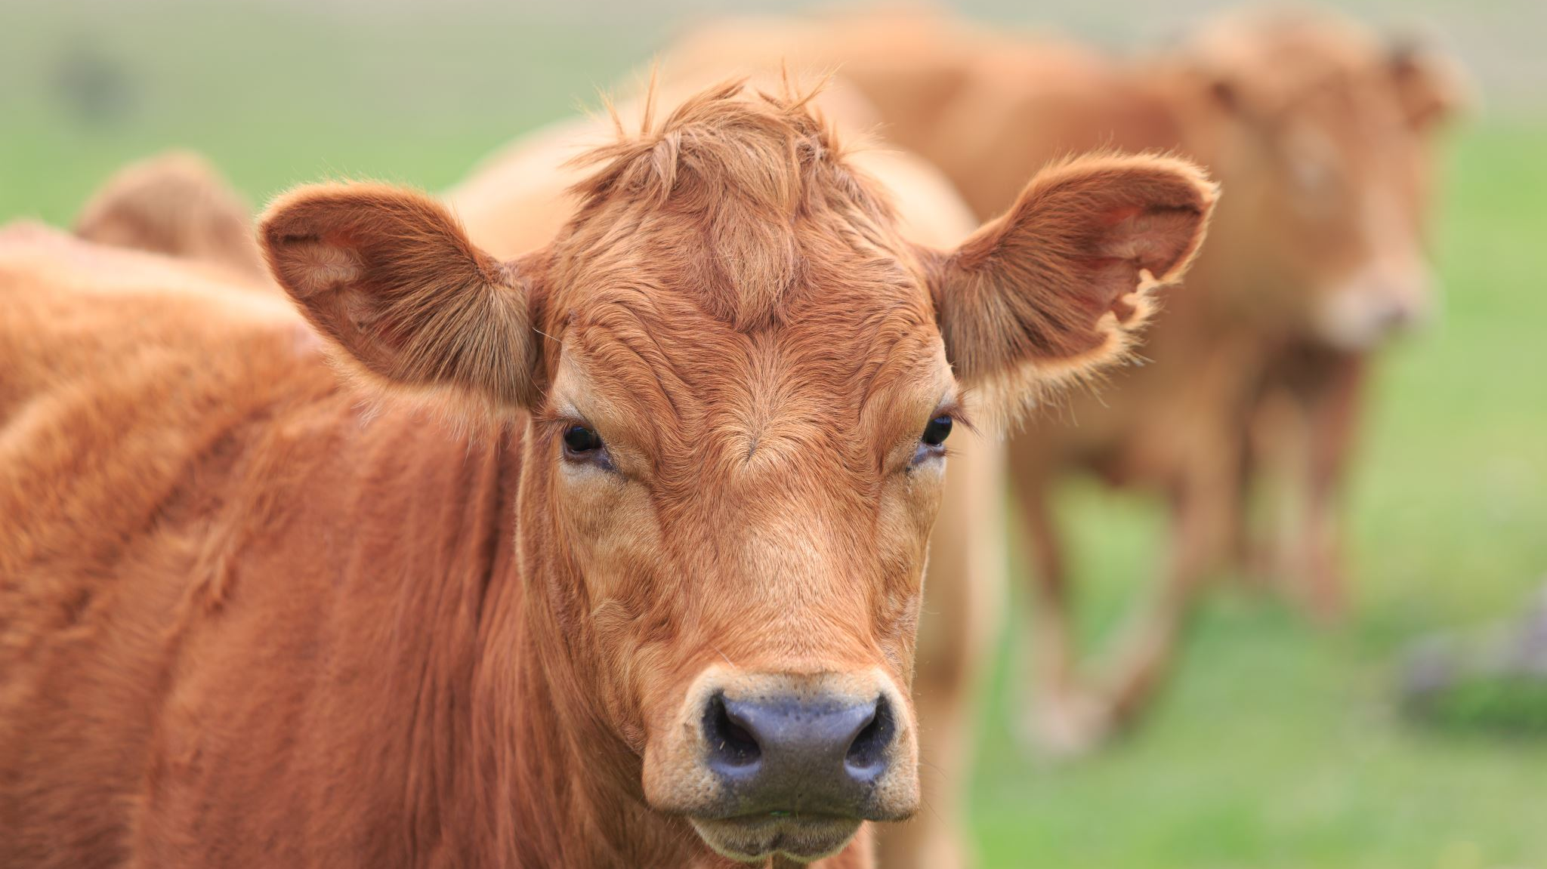
Beef Cattle

Slide 10
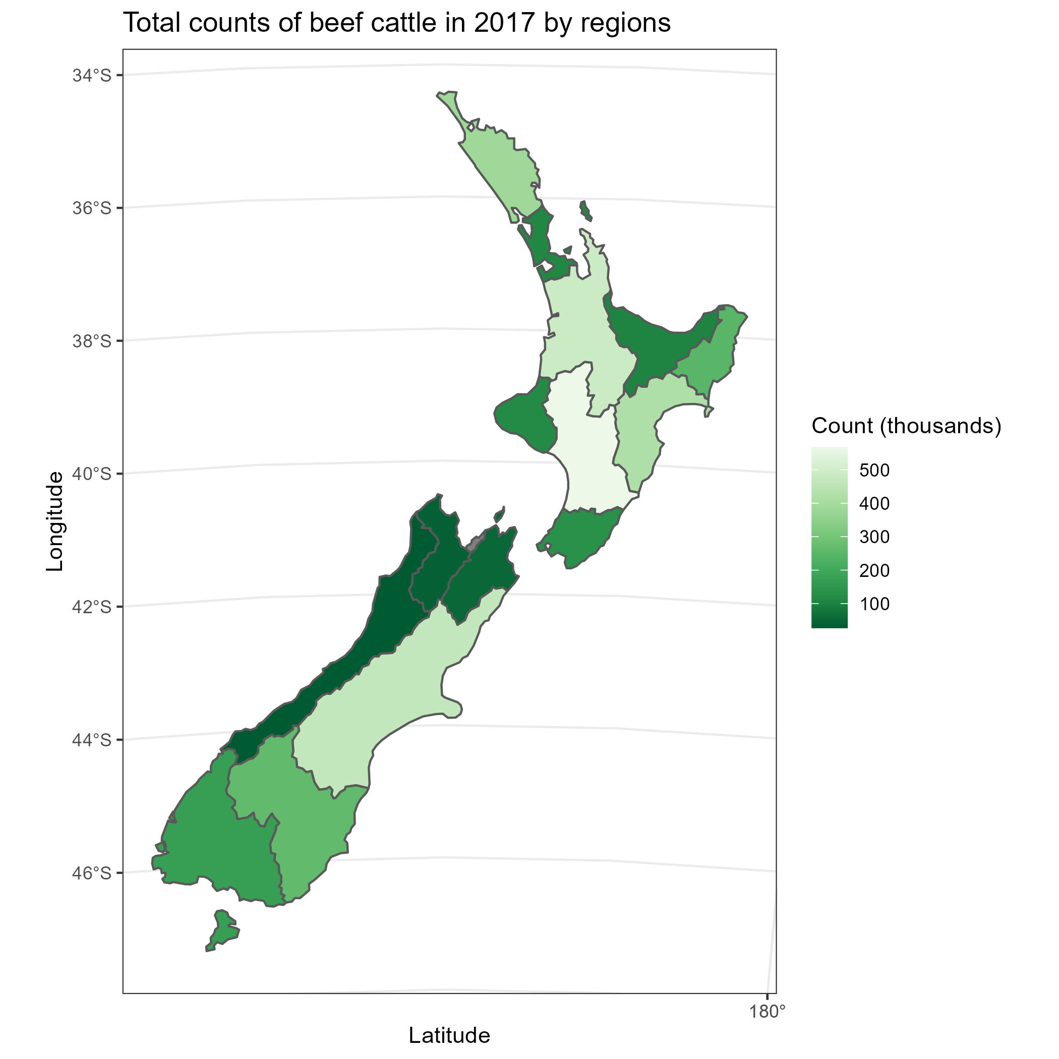

Beef Cattle in 2017
Northland
Waikato
Major Sheep and beef cattle farms:
Manawatu-Wanganui
Canterbury
There were much fewer beef cattle than sheep (around 1/6)
Manawatu-Wanganui
Canterbury
Chatham Islands

Slide 11
North Island Beef Cattle Counts
Key Findings:
The beef cattle count in Bay of Plenty and Taranaki increased by around 13% from 2012 to 2017
The counts in the large beef cattle farms (Hawke’s Bay, Manawatu-Wanganui and Waikato) decreased between 2% to 6%

Slide 12
South Island Beef Cattle Counts
Key Findings:
Slight reduction in Canterbury
Significant reductions in Otago and Marlborough
Data unavailable: Nelson (2012, 2017) and Chatham Islands (2012)

Slide 13
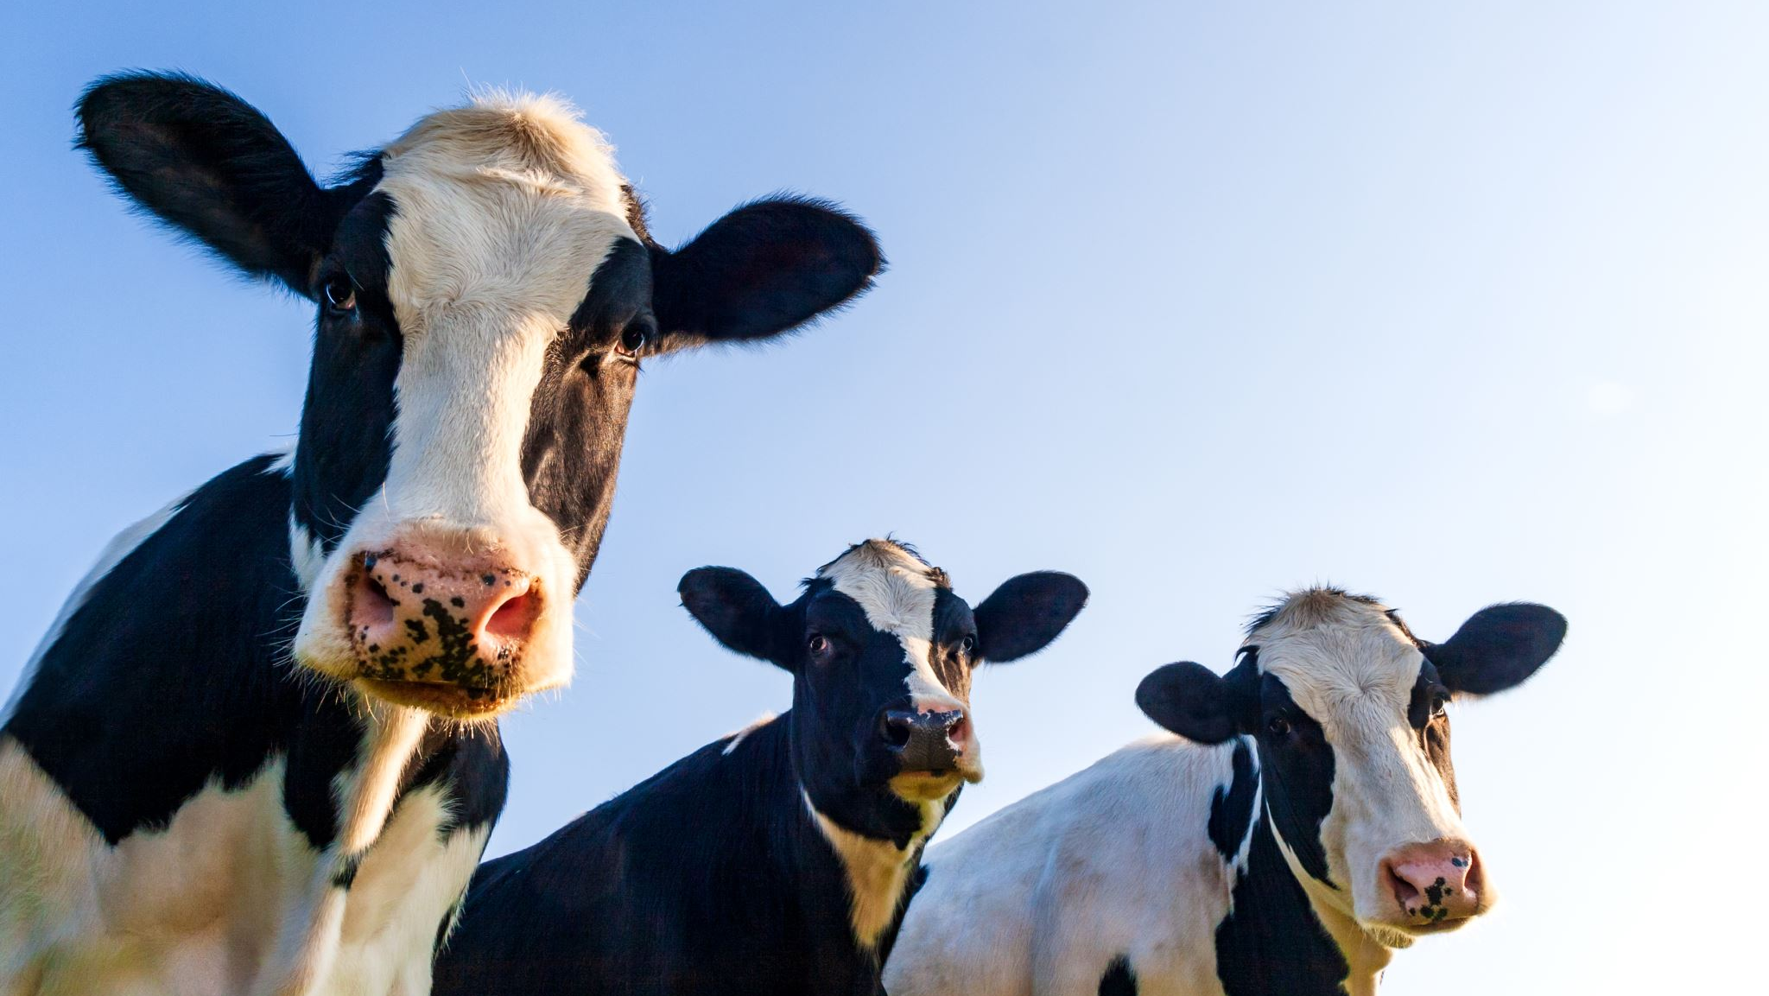
Dairy Cattle

Slide 14
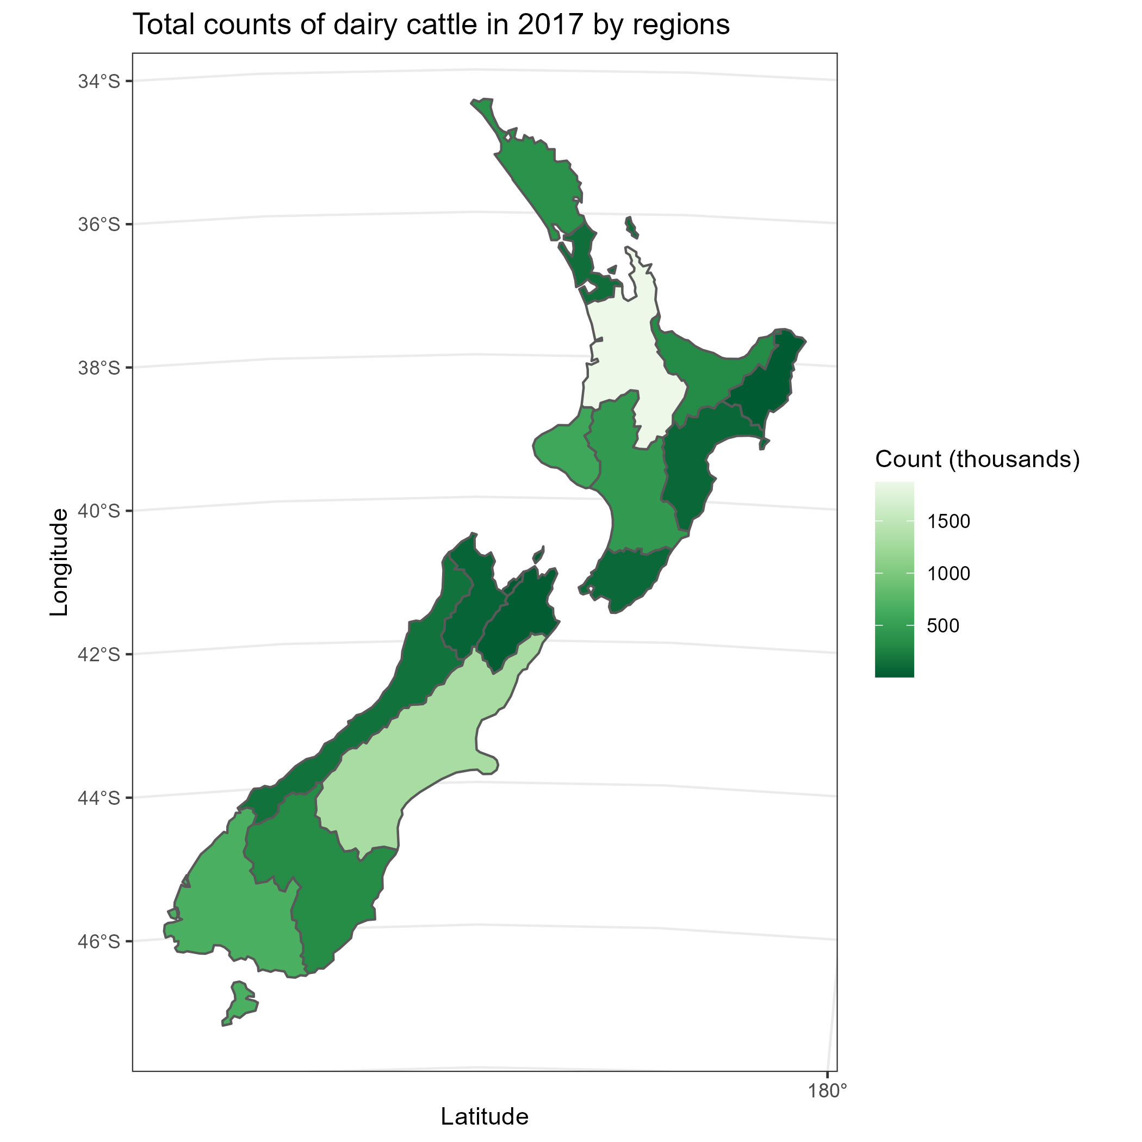
Dairy Cattle in 2017
Waikato
Waikato and Canterbury had the largest dairy cattle farms in New Zealand
More than 1300 thousand cattle
Canterbury

Slide 15
North Island Dairy Cattle Counts
Key Findings:
The counts increased by 2.1% in Waikato.
The total counts from the North Island stayed stable from 2012 to 2017.

Slide 16
South Island Dairy Cattle Counts
Key Findings:
The counts increased significantly in Canterbury (by 9.0%).
The total counts from the South Island increased by 3.4%
Data unavailable: Nelson (2012) and Chatham Islands (2012, 2017)

Slide 17
Conclusions
The patterns of livestock distributions stayed largely unchanged from 2012 to 2017.
1. The leading type of livestock: sheep
2. The sheep and beef cattle farming shrunk from 2012 to 2017.
- The counts were reduced in all the major regions
3. The farming of dairy cattle expanded.
- Major contributors: Waikato and Canterbury.

Slide 18
Appendix
Data Source: Agricultural production statistics: June 2017 (final)
https://www.stats.govt.nz/information-releases/agricultural-production-statistics-june-2017-final
GitHub Repository:
https://github.com/wang-emma/Stats-NZ-Livestock2017.git
What’s next?
What are the reasons for the shrinking beef cattle and sheep farming?
What are the economic and environmental impacts of these changes?

